Slide 1
FIND THE OPTIMAL LOCATION FOR A BUSINESS
Applied Data Science Capstone
IBM Data Science Professional Certificate
fEB 2018

Slide 2
Synopsis
Part 1: Problem Description
In this project, the problem attempted to solve will be to find the best possible location or the most optimal, for an Indian restaurant in the city of London, United Kingdom. To achieve this task, an analytical approach will be used, based on advanced machine learning techniques and data analysis, concretely clustering and perhaps some data visualization techniques.

Slide 3
Synopsis
Part 1: Problem Description
During the process of analysis, several data transformations will be performed, in order the find the best possible data format for the machine learning model to ingest. Once the data is set up and prepared, a modeling process will be carried out, and this statistical analysis will provide the best possible places to locate the Indian restaurant.

Slide 4
Synopsis
Part 2: Data We Need
The data that will be used to develop this project is based on two sites:
1) The Foursquare Api: This data will be accesed via Python, and used to obtain the most common venues per neighborhood in the city of Madrid. This way, it is possible to have a taste of how the city's venues are distributed, what are the most common places for leisure, and in general, it will provide an idea of what people's likes are.

Slide 5
Synopsis
Part 2: Data We Need
2) The www.doogal.co.uk Website: This site provides several data sources of great utility to solve this problem. The files are provided in csv format, and they are built over a statstical exploitation and use basis. The data contains updated information about the postcodes and locations of Boroughs and neighborhoods in London. This data will be analyzed in such a way that one could determine the best location of r anew venue/restaurant/other based on similarities between neighborhoods and the rating of differents restaurants.

Slide 6
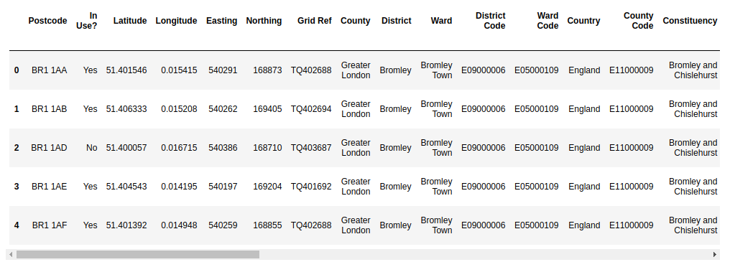
Synopsis
Part 2: Data We Need
This is an example of the data provided by “doogal” :

Slide 7
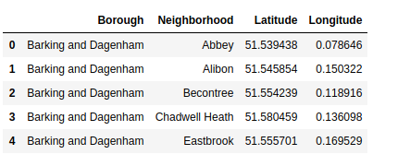
Main Article
Part 1: After cleaning the data and choosing the columns we need from London DataFrame, this is how the data looks like :

Slide 8
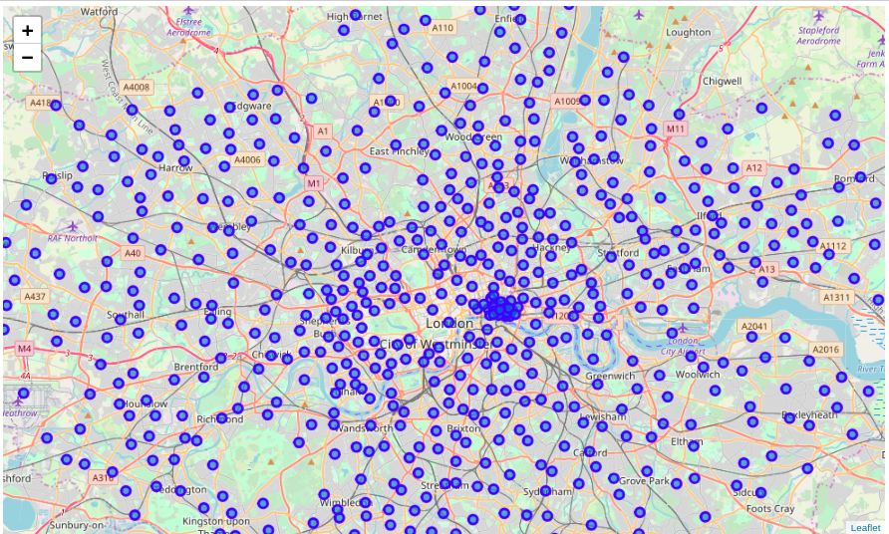
Main Article
Part 1: Identifying Postal Codes (and then Neighborhoods) in "London"

Slide 9
Main Article
Part 2: Connecting to Foursquare and Retrieving Locational Data for Each Venue in Every Neighborhood
After finding the list of neighborhoods, we then connect to the Foursquare API to gather information about venues inside each and every neighborhood. For each neighborhood, we have chosen the radius to be 500 meters. It means that we have asked Foursquare to find venues that are at most 500 meter far from the center of the neighborhood.

Slide 10
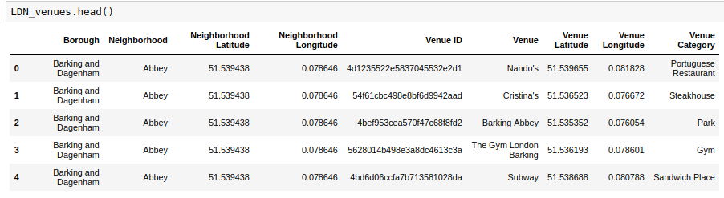
Main Article
Part 2: Connecting to Foursquare and Retrieving
This is how the data looks like :

Slide 11
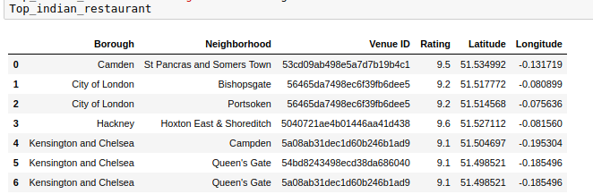
Main Article
Part 2:
After importing and cleaning the data about the venues in London, we proceed finding the Best Indian Restaurants based on their rating ( rating >= 9.0)

Slide 12
Main Article
Part 3: Processing the Retrieved Data and Creating a DataFrame for All the Venues inside the London. We choose to delete the boroughs of these best restaurants from these venues to avoid competition with these kind of restaurants. The next step will be then find the nearest neighborhood of those venues where we can find the top Indian Restaurants.

Slide 13
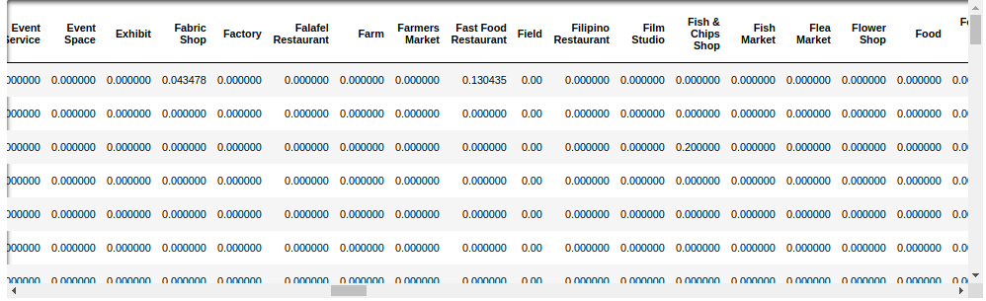
Important criteria :
We group our data by boroughs and neighborhoods by taking the average of these values. Then we delete from these data the boroughs were we could find the best Indian Restaurant. We have chosen this criteria because we want to be far from competition of these good restaurants.

Slide 14
Main Article
Part 4: Applying one of Machine Learning Techniques (KNN)
We will use “Manually” the 3-NN to find foreach one of the best Indian Restaurants the best 3 places similar to the ones where these restaurants are located :

Slide 15
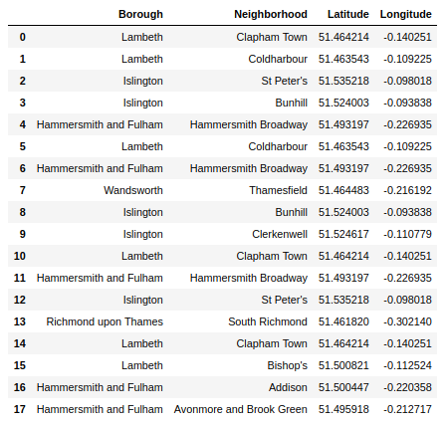
Decision Making and Reporting Results

Slide 16
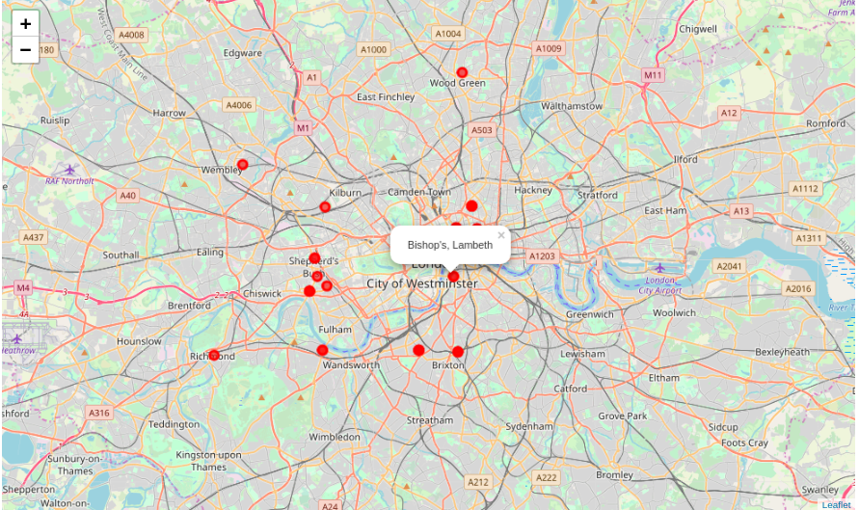
Decision Making and Reporting Results

Slide 17
THANK YOU!
Nizar

